Slide 1
AGILE: An overview
POURNAA K
SCRUM MASTER
ADM21DN016

Slide 2
SYNOPSIS
Agile documents
Roles in agile
Scrum in agile
Scrum framework
Working of scrum
Difference between agile and scrum
Sprint planning
Sprint planning for us
Sprint Backlog
Sprint review
Sprint retrospective
Advantages over waterfall

Slide 3
AGILE DOCUMENTS
Abstract
Product Backlog
High level design
Wireframe

Slide 4
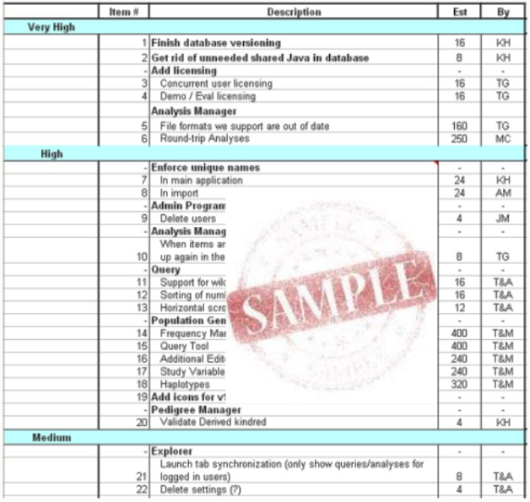
PRODUCT BACKLOG:

Slide 5
ROLES IN AGILE
Scrum Master
Product owner
Team (Technical)

Slide 6
SCRUM IN AGILE
Scrum in Agile is a process that allows software development teams to focus on delivering business values in shortest time by rapidly and repeatedly inspecting actual working software. It focuses on accountability, teamwork and iterative progress towards well-defined goals. Scrum Framework usually deals with fact that requirements are likely to change or mostly not known at the beginning of project.

Slide 7
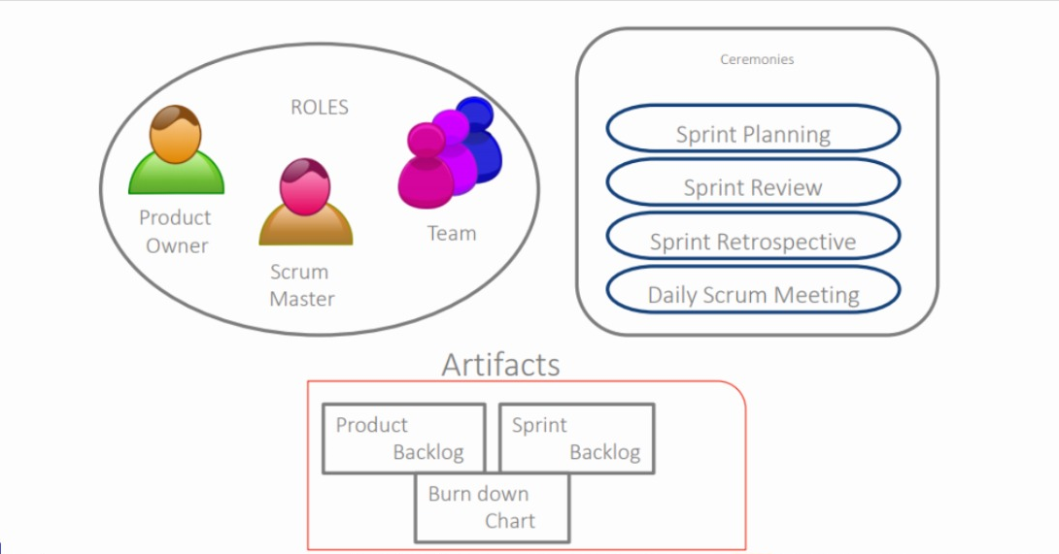
SCRUM FRAMEWORK

Slide 8
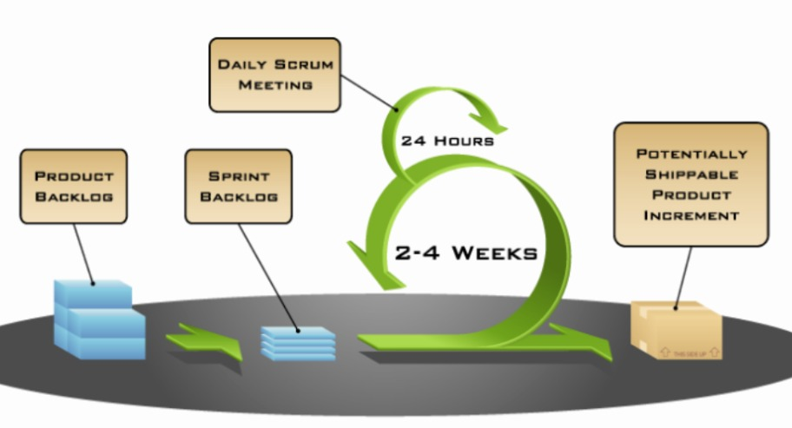
WORKING OF SCRUM

Slide 9
AGILE
SCRUM
The continuous iteration of development and testing in the software development process
Delivers the software on a regular basis for feedback
Leadership plays a vital role
Involves collaborations and face-to-face interactions between the members of various cross-functional teams
Design and execution should be kept simple
Focuses on delivering the business value in the shortest time
Delivers the software after each sprint
Fosters a self-organizing, cross-functional team
Scrum collaboration is achieved in daily stand up meetings
Design and execution can be innovative and experimental

Slide 10
SPRINT PLANNING :
Sprint planning is an event in the Scrum framework where the team determines the product backlog items they will work on during that sprint and discusses their initial plan for completing those product backlog items
The purpose of sprint planning is to define what can be delivered in the sprint and how that work will be achieved
WHO DOES SPRINT PLANNING?

Slide 11
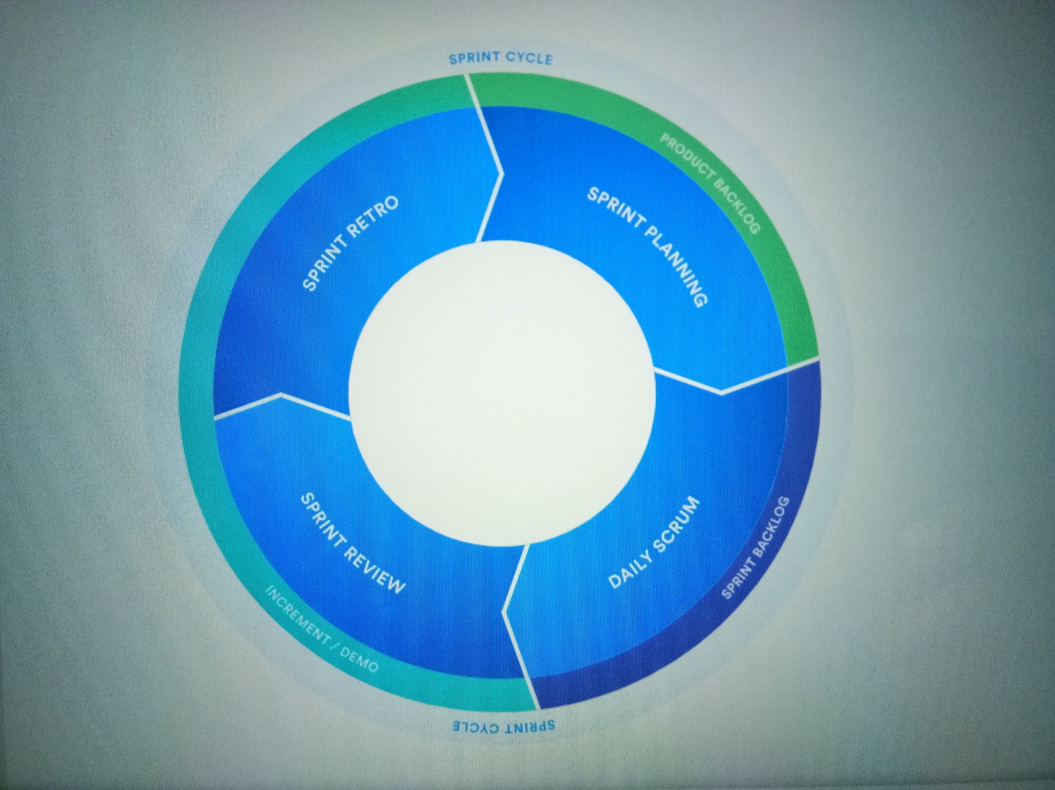

Slide 12
SPRINT PLANNING FOR US: June 16th – June 26th , 2021
SPRINT NUMBER : | WORK: | DAYS:
Sprint -1 | Data Base and UI (in MVC) | 2 days
Sprint -2 | MVC code | 5 days
Sprint -3 | Overall Code Compilation and testing | 3 days

Slide 13
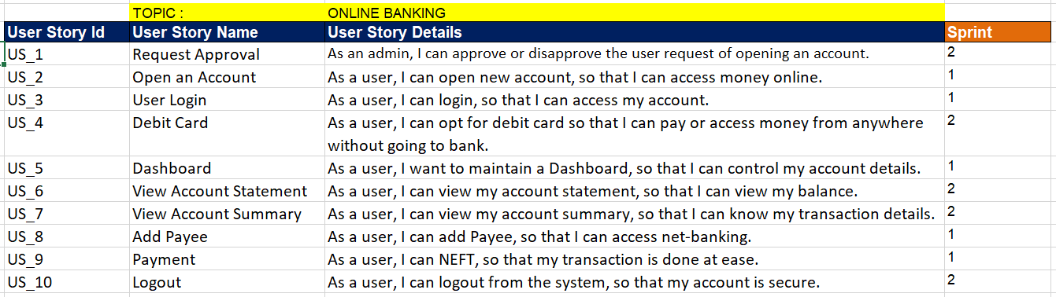
SPRINT PLANNING

Slide 14
SPRINT BACKLOG
User stories in Product Backlog is classified into sprints and completed in the respective sprints
Sprint backlog is allotting the time(hrs needed to complete the task) for each User Stories everyday in the given sprint
In a sprint, One whole task has to be divided into smaller tasks and given to each members to be completed in the given hours.

Slide 15
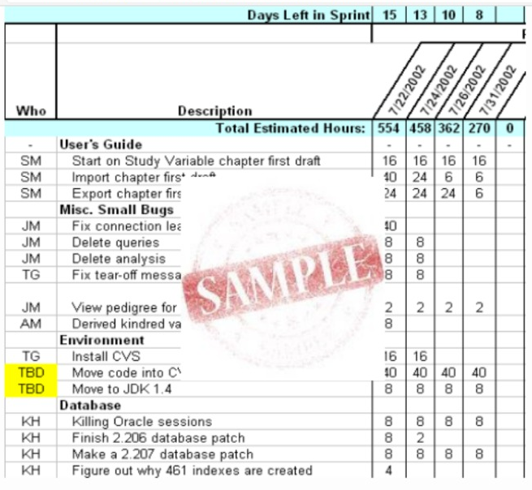
SPRINT BACKLOG

Slide 16
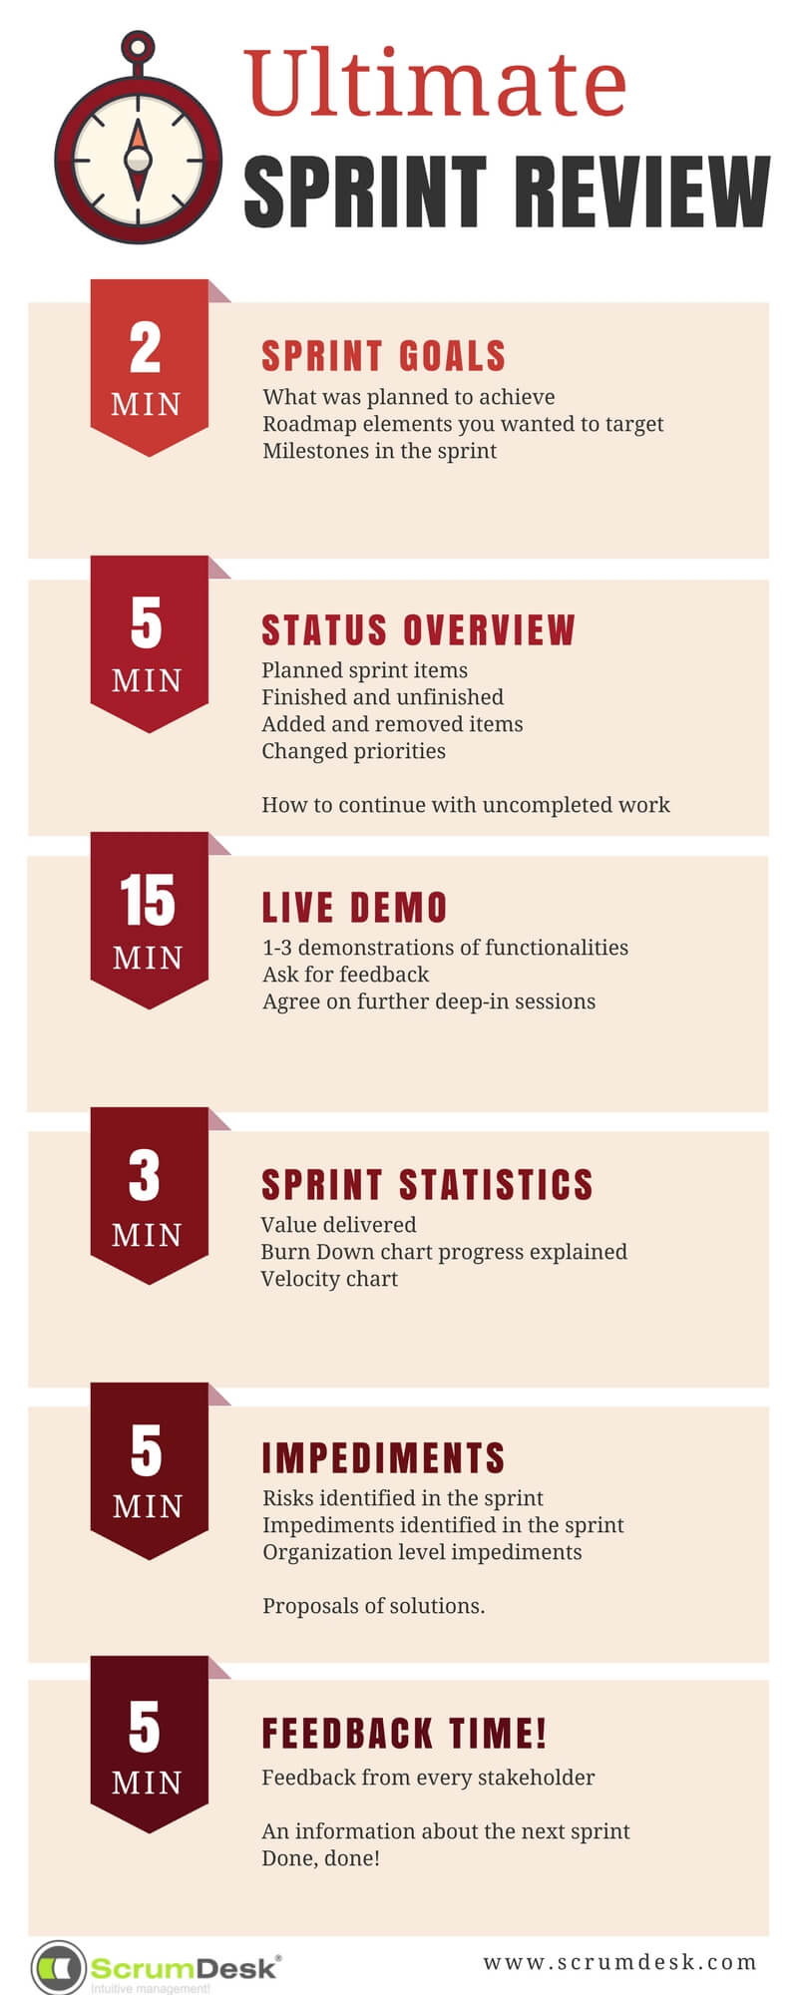

Slide 17
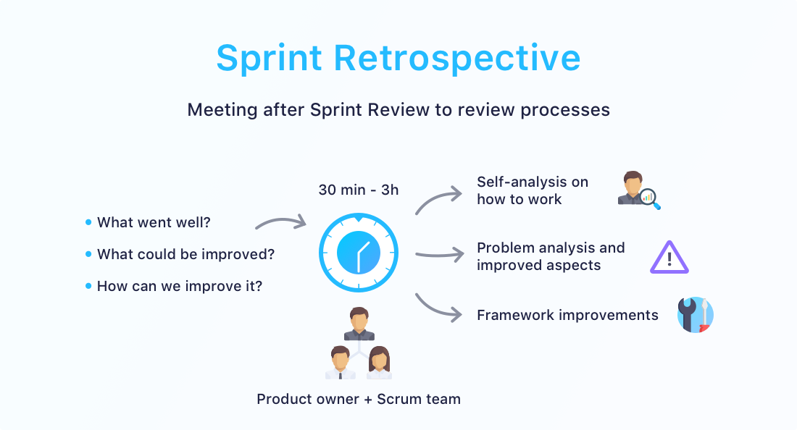

Slide 18
ADVANTAGES OVER WATERFALL:
Increase the quality of the deliverables
Cope better with change (and expect the changes)
Provide better estimates while spending less time creating them
Be more in control of the project schedule and state

Slide 19
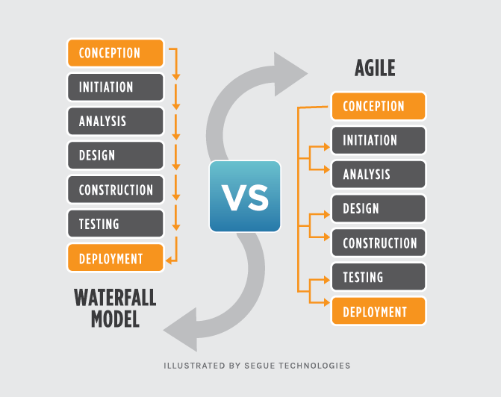

Slide 20
THANK YOU !

